Slide 1

August 31, 2035
PAG-ASA SENIOR HIGH
Research
Presentation
Presentation by Jonel Estanislao
Class 11-A
1

Slide 2

PAG-ASA SENIOR HIGH
Background
The introduction provides the background and context of the research topic. It explains the situation, issue, or condition that led to the conduct of the study. This section helps the audience understand why the topic is important, timely, and relevant, and how it connects to real-life situations or existing concerns.
Estanislao | 11-A
2

Slide 3
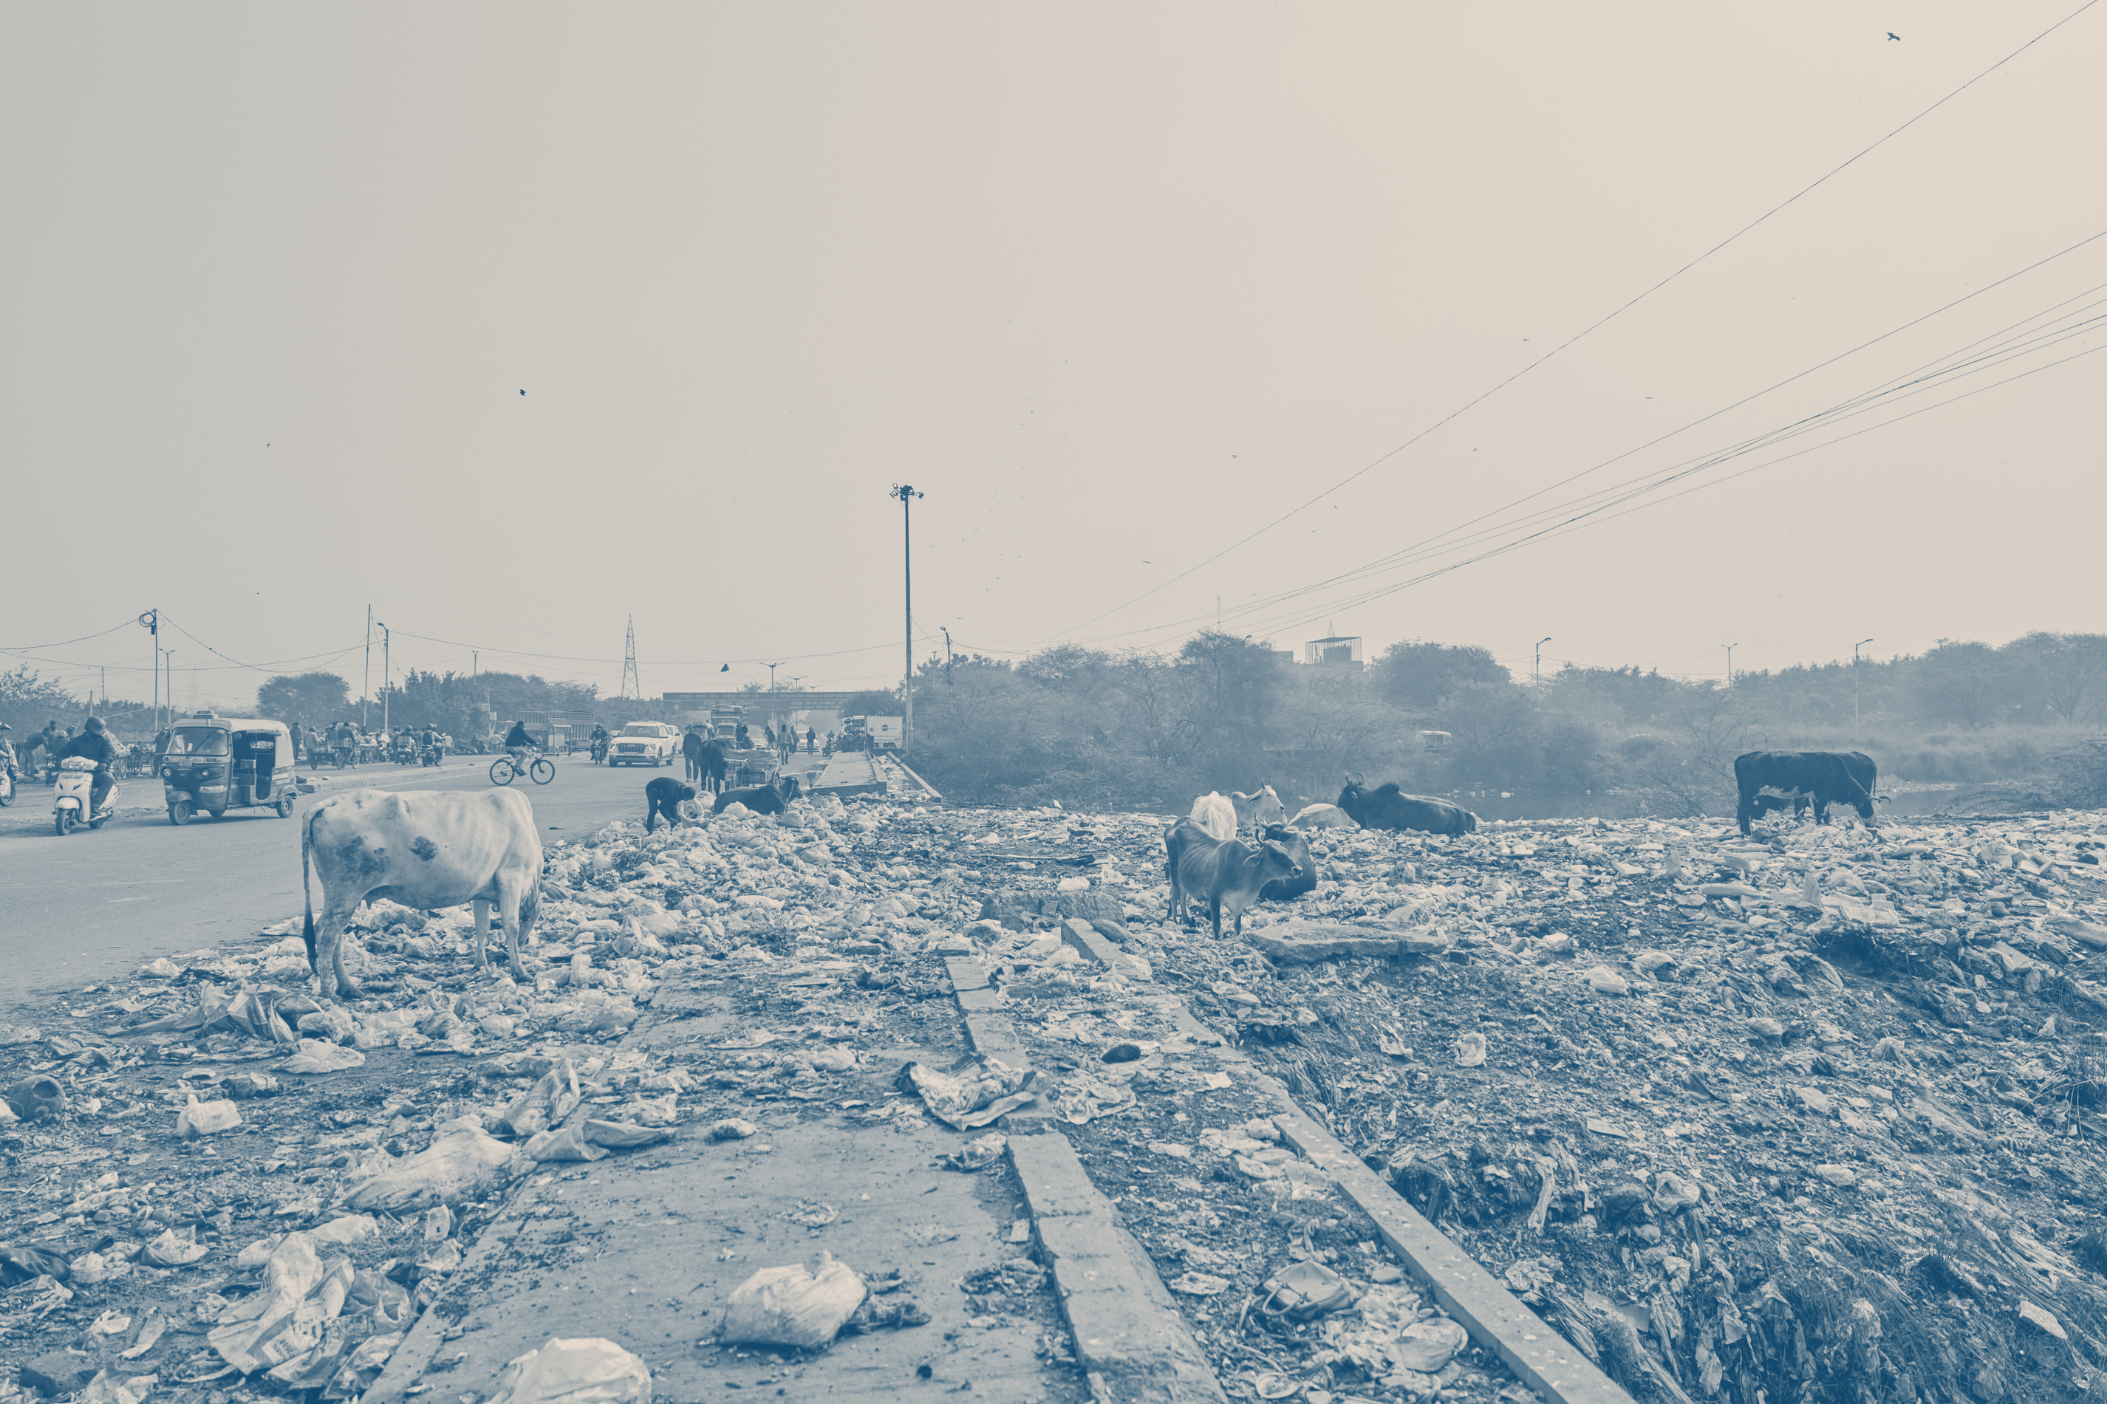
PAG-ASA SENIOR HIGH
This slide explains the main purpose of the research. It clearly states what the study aims to achieve or discover. The purpose gives direction to the research and helps the audience understand the overall goal of the study and what the researchers hoped to accomplish.
Purpose of the study
This slide explains the main purpose of the research. It clearly states what the study aims to achieve or discover. The purpose gives direction to the research and helps the audience understand the overall goal of the study.
Estanislao | 11-A
3

Slide 4
PAG-ASA SENIOR HIGH
Research questions
The research questions guide the entire study. This section presents the key questions that the research seeks to answer. These questions define the focus of the study and determine what data were collected and analyzed during the research process.
01
Question
02
Question
This section presents the main questions that guided the study. These questions define what the research seeks to answer and serve as the basis for data collection and analysis.
This section presents the main questions that guided the study. These questions define what the research seeks to answer and serve as the basis for data collection and analysis.
Estanislao | 11-A
4

Slide 5
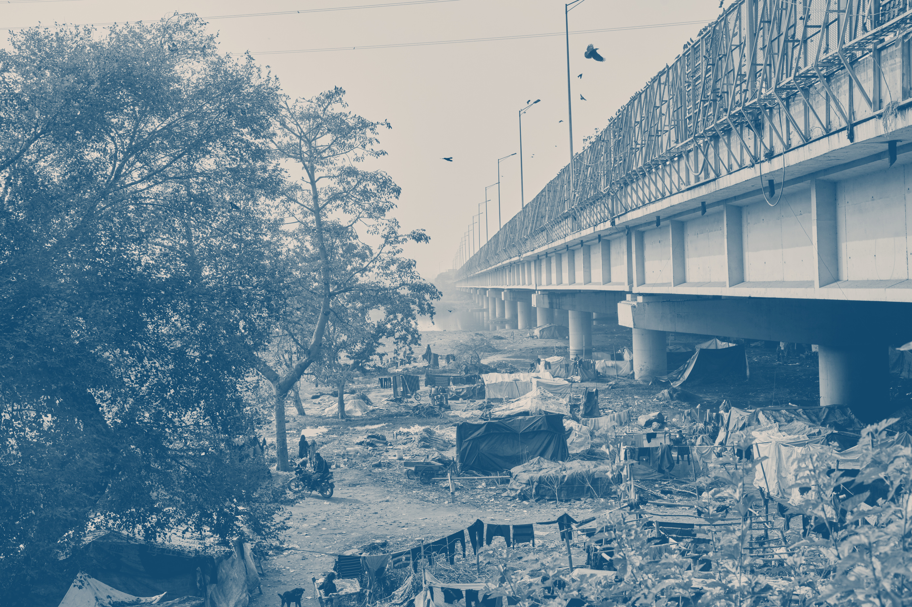
PAG-ASA SENIOR HIGH
Methodology
This slide provides a general overview of how the research was conducted. It briefly describes the research design and the methods used to gather data. The goal of this section is to give the audience a clear idea of the research process without going into technical or complex details.
This slide provides a general overview of how the research was conducted. It briefly describes the research design and the methods used to gather data. The goal of this section is to give the audience a clear idea of the research process without going into technical or complex details.
Estanislao | 11-A
5

Slide 6
PAG-ASA SENIOR HIGH
01
Source
02
Source
Data source
This section describes who participated in the study or where the data came from. It may include information about the respondents, subjects, or sources of data used.
This section describes who participated in the study or where the data came from. It may include information about the respondents, subjects, or sources of data used.
This section describes who participated in the study or where the data came from. It may include information about the respondents, subjects, or sources of data used. This slide helps the audience understand whose experiences, opinions, or information were considered in the research.
03
Source
04
Source
This section describes who participated in the study or where the data came from. It may include information about the respondents, subjects, or sources of data used.
This section describes who participated in the study or where the data came from. It may include information about the respondents, subjects, or sources of data used.
Estanislao | 11-A
6

Slide 7
PAG-ASA SENIOR HIGH
01
Results
Key findings
This slide presents the most important results of the study. Findings may be shown through charts, graphs, or summarized statements to make the data easy to understand.
02
Results
The key findings slide presents the most important results of the study. It highlights patterns, trends, or significant outcomes based on the collected data. Information may be summarized using charts, graphs, or short statements to make the results easier to understand.
This slide presents the most important results of the study. Findings may be shown through charts, graphs, or summarized statements to make the data easy to understand.
03
Results
This slide presents the most important results of the study. Findings may be shown through charts, graphs, or summarized statements to make the data easy to understand.
Estanislao | 11-A
7

Slide 8
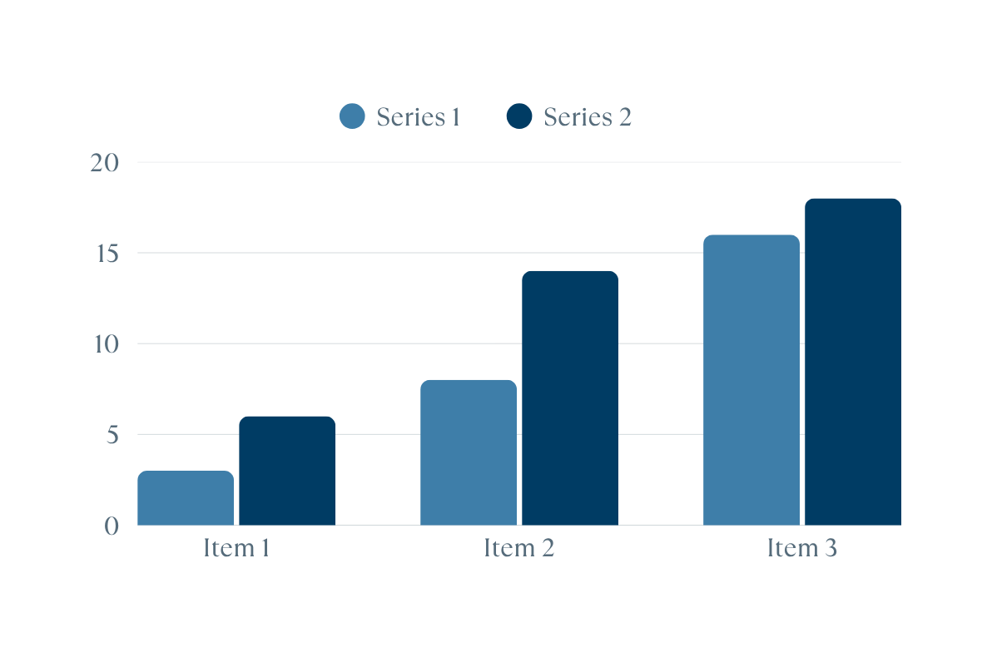
PAG-ASA SENIOR HIGH
Key findings
The key findings slide presents the most important results of the study. It highlights patterns, trends, or significant outcomes based on the collected data. Information may be summarized using charts, graphs, or short statements to make the results easier to understand.
This slide presents the most important results of the study. Findings may be shown through charts, graphs, or summarized statements to make the data easy to understand.
Estanislao | 11-A
8

Slide 9

PAG-ASA SENIOR HIGH
Discussion
The discussion explains the meaning of the findings. It interprets the results and connects them to the research questions and purpose of the study. This section helps the audience understand what the results imply and why they are important.
The discussion explains the meaning of the findings. It interprets the results and connects them to the research questions and purpose of the study. This section helps the audience understand what the results imply and why they are important.
Estanislao | 11-A
9

Slide 10
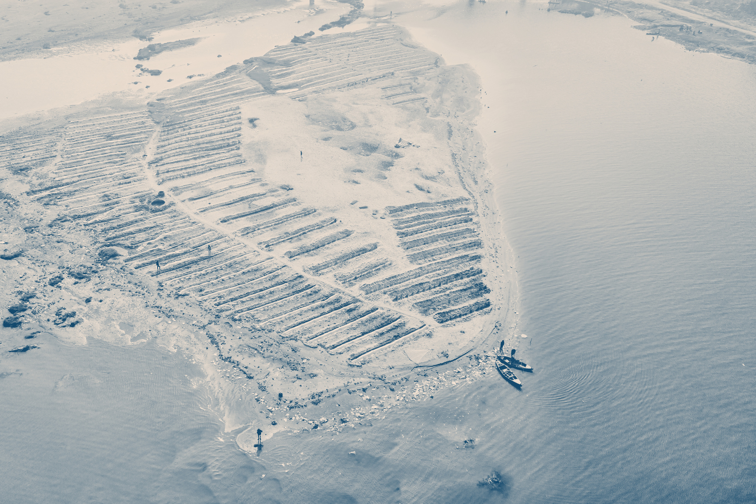
PAG-ASA SENIOR HIGH
Conclusion
The conclusion summarizes the overall results of the research. It explains what was learned from the study and whether the research purpose was achieved. This section highlights the main takeaway and overall significance of the research.
The conclusion summarizes the overall results of the research. It explains what was learned from the study and whether the research purpose was achieved. This section highlights the main takeaway and overall significance of the research.
The conclusion summarizes the overall results of the research. It explains what was learned from the study and whether the research purpose was achieved. This section highlights the main takeaway and overall significance of the research.
Estanislao | 11-A
10

Slide 11
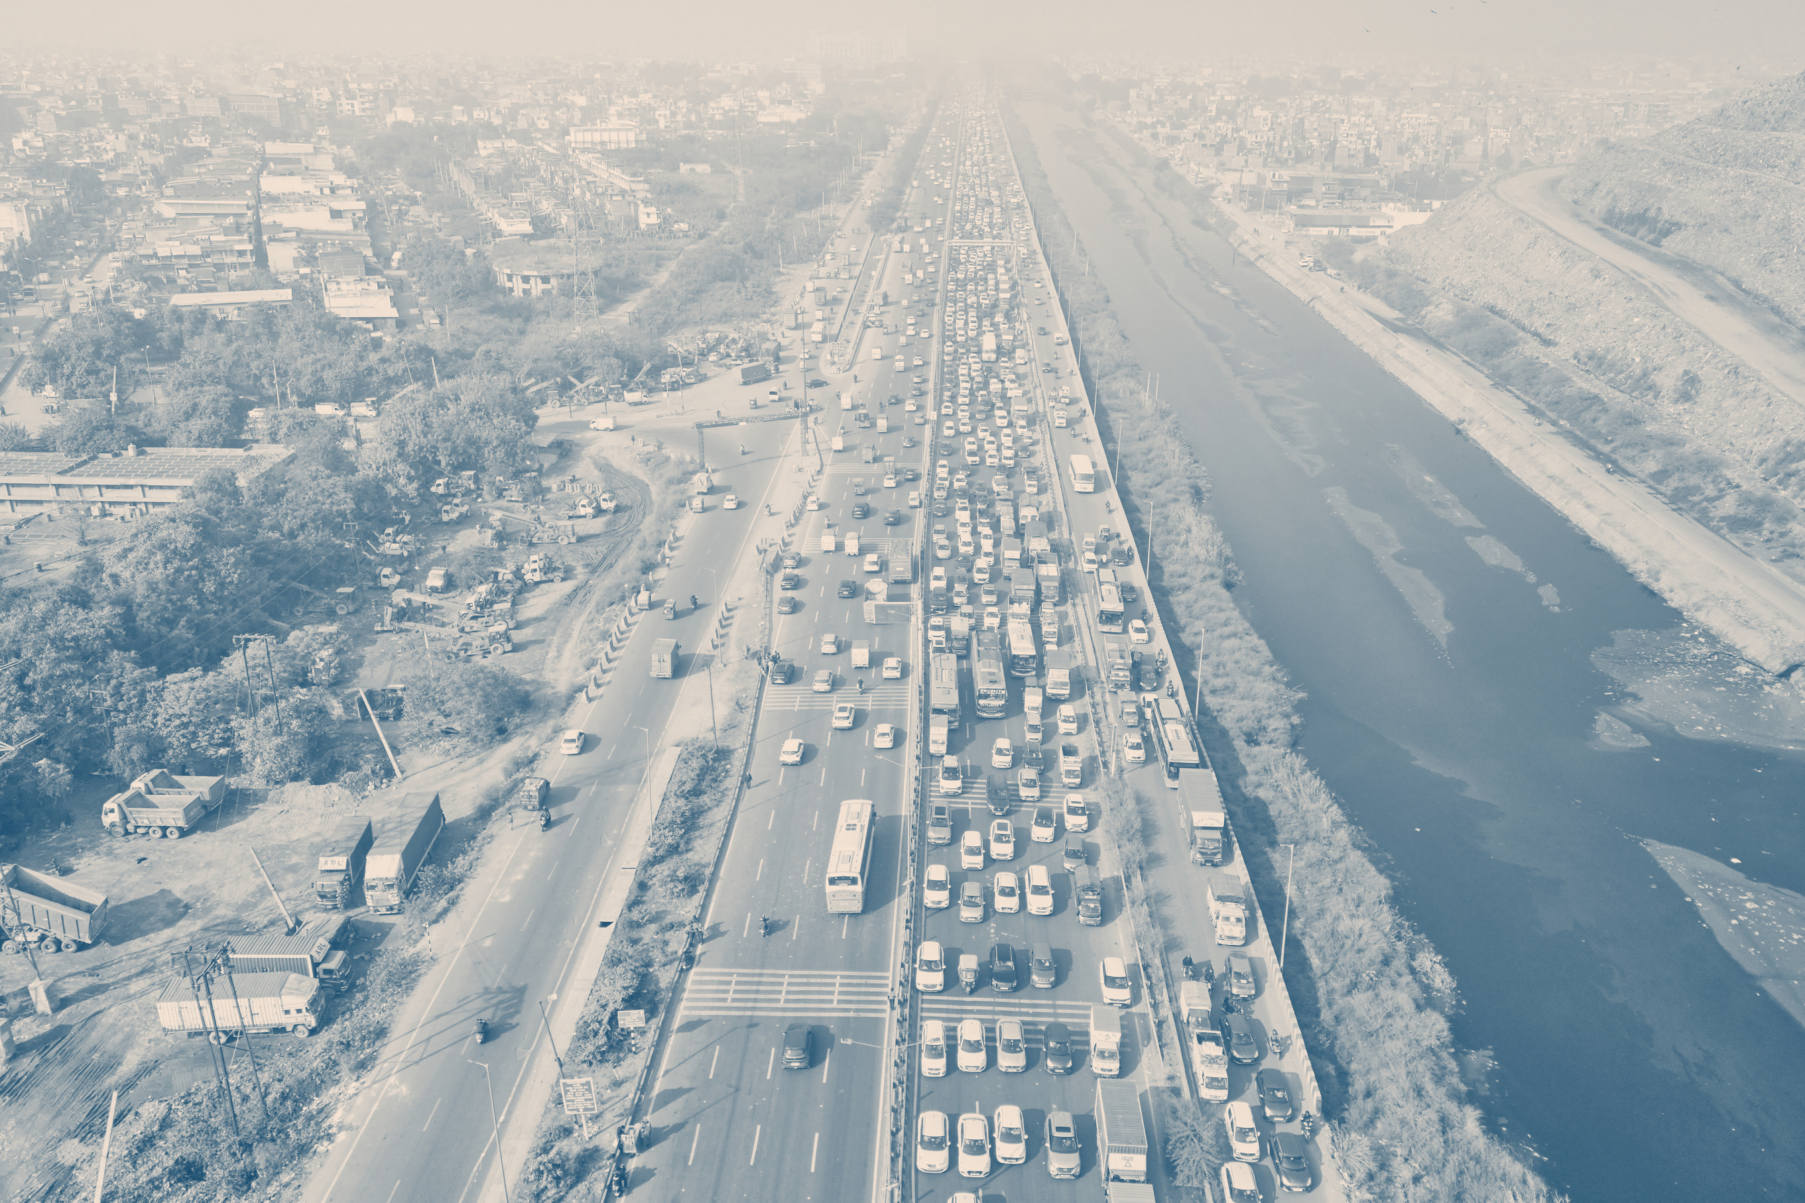
PAG-ASA SENIOR HIGH
Recommendations
Recommendations may include possible actions, improvements, or areas for future research. This section shows how the study can be useful and applied beyond the presentation.
01
Recommendations may include possible actions, improvements, or areas for future research. This section shows how the study can be useful and applied beyond the presentation.
02
Recommendations may include possible actions, improvements, or areas for future research. This section shows how the study can be useful and applied beyond the presentation.
03
Estanislao | 11-A
11

Slide 12
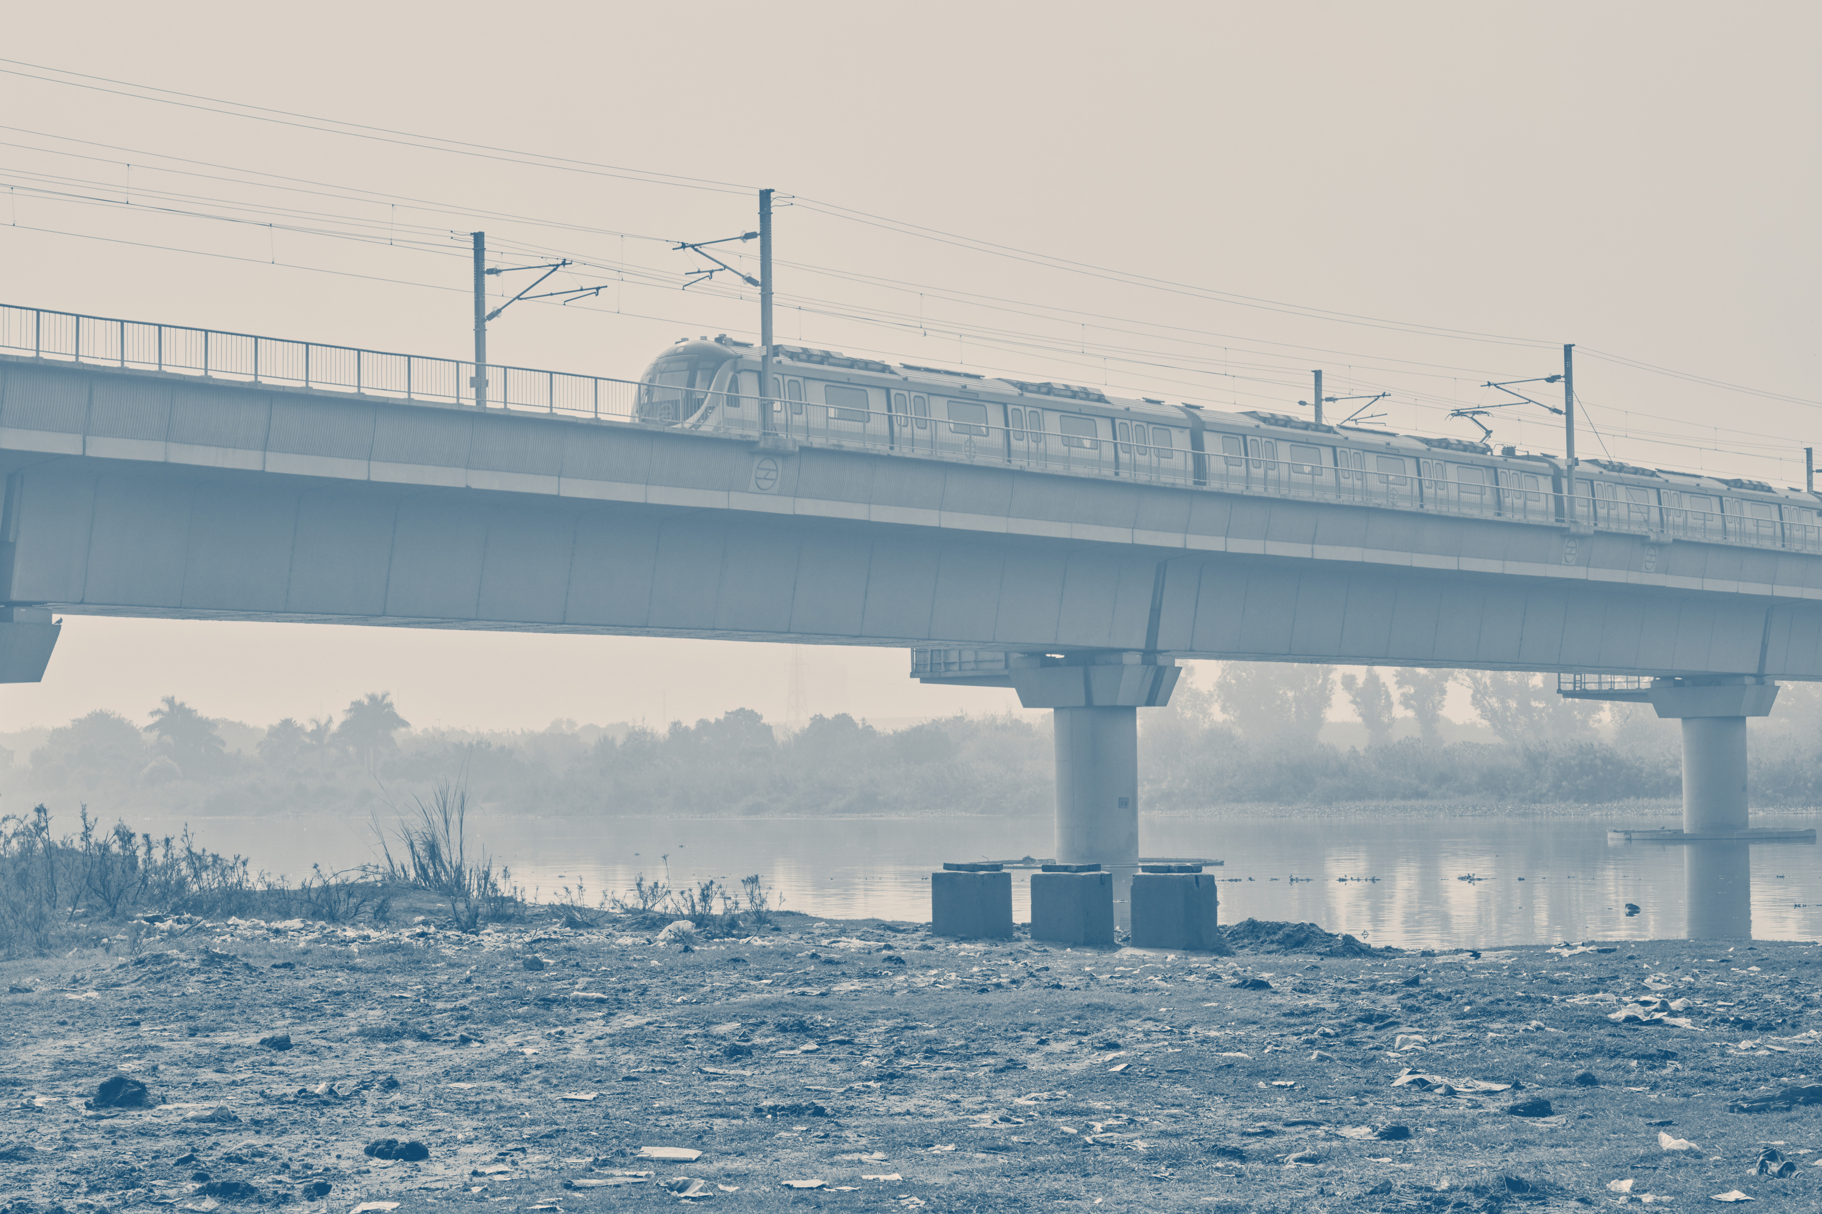
Thank You
Jonel Estanislao | Class 11-A
12

